Slide 1
Strategies to Check Student Learning in the Classroom
Classroom Assessment Techniques (CATs)

Slide 2
Presentation Outline
What are Classroom Assessment Techniques (CATs)?
What are the Benefits of CATs for Teachers and Students?
What Kinds of Evaluations are CATs Designed to Perform?
What are the Kinds of Evaluations?

Slide 3
Classroom Assessment Techniques (CATs)
What are CATs?

Slide 4
Classroom Assessment Techniques (CATs)
Formative Evaluation Methods

Slide 5
Classroom Assessment Techniques (CATs)
Formative Evaluation Methods serve 2 purposes:
  Course Content
  Methods of teaching and student learning

Slide 6
Classroom Assessment Techniques (CATs)
Formative Evaluation Methods are most effective when:
  They are done frequently
  Feedback is used immediately in the day-to-day course operations

Slide 7
Classroom Assessment Techniques (CATs)
CATs help:
  Assess the degree to which your students understand the course content
  Provide you with information about the effectiveness of your teaching methods

Slide 8
Classroom Assessment Techniques (CATs)
What are the Benefits for Teachers and for Students?

Slide 9
Benefits for Teachers
CATs provide teachers with:
  Day-to-day feedback that can be applied immediately
  Useful information about what students have learned
CATs allow teachers to address:
  Student misconceptions in a timely way
  Lack of understanding in a timely way
Notes:
How do teachers benefit?

Slide 10
Benefits for Teachers
CATs help teachers to
  Develop better working relationships with students
  Help students understand that teaching and learning are on-going processes

Slide 11
Benefits for Students
CATs help students to
  develop self-assessment
  develop learning management skills
  Reduce feelings of isolation and powerlessness
    especially in large classes
Notes:
How do students benefit?

Slide 12
Benefits for Students
CATs help to
  Increase students’ understanding
  Increase ability to think critically
  Foster attitudes that value understanding and long-term retention
  Demonstrate to the students a teacher’s interest and caring about their success

Slide 13
Classroom Assessment Techniques (CATs)
What Kinds of Evaluations are CATs Designed to Perform?

Slide 14
CATs Performance
CATs are designed to do three things:
  Course-related Knowledge and Skills
  Student Attitudes, Values, and Self-awareness
  Reactions to Instruction Methods

Slide 15
CATs Performance
Course-related Knowledge and Skills
  Prior knowledge, recall and understanding
  Analysis and critical thinking skills
  Synthesis and creative thinking skills
  Problem solving skills
  Application and performance skills

Slide 16
CATs Performance
2. Student Attitudes, Values, and Self-awareness
  Values and attitudes
  Learning processes
  Skills

Slide 17
CATs Performance
3. Reactions to Instruction methods
  Student and peer reactions to
    Teachers and teaching
    Class activities
    Assignments
    Course materials

Slide 18
Classroom Assessment Techniques (CATs)
What are the Kinds of Evaluations?

Slide 19
CATs Evaluation One
Course-related Knowledge and Skills
  One-Minute Paper
  Muddiest Point
  Chain Notes
  Application Article
  Student Generated Test Questions

Slide 20
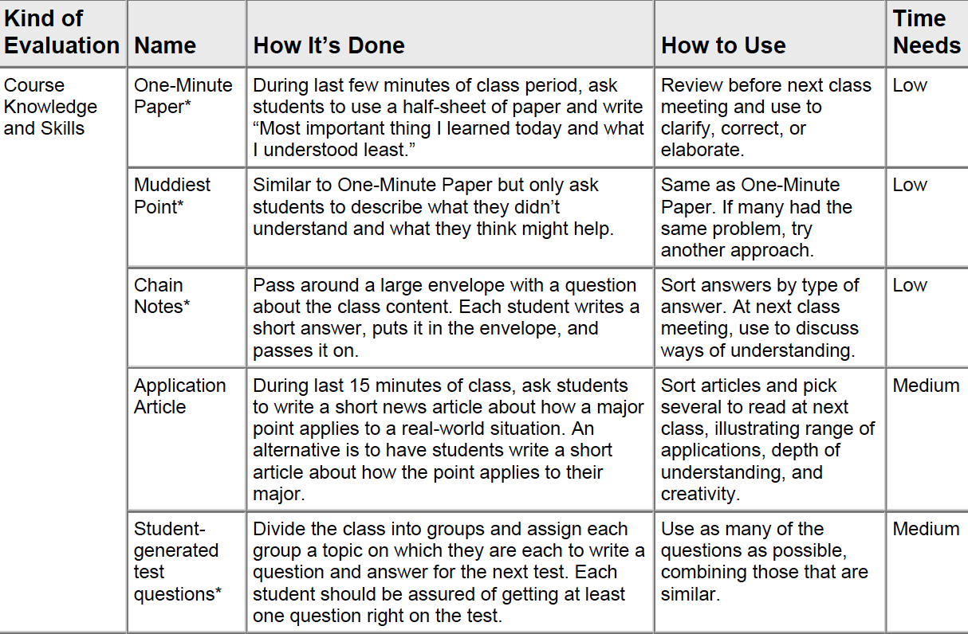

Slide 21
CATs: Evaluation Two
Attitudes, Values, and Self-Awareness
  Journals

Slide 22
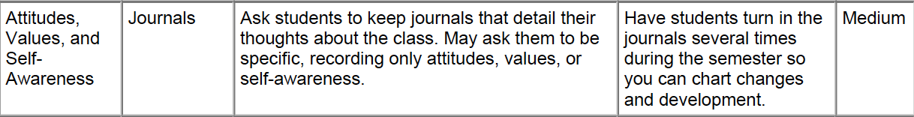

Slide 23
CATs: Evaluation Three
Reactions to Instruction
  Exam Evaluations
  Student Rep Group
  Suggestion Box
  Peer Review

Slide 24
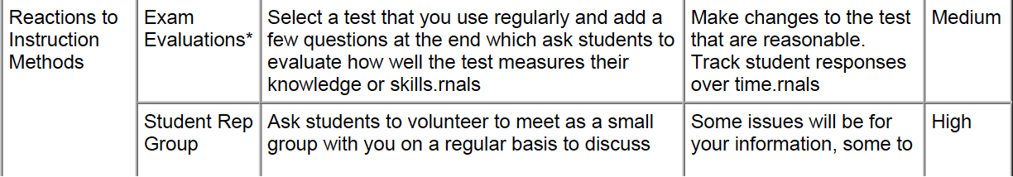
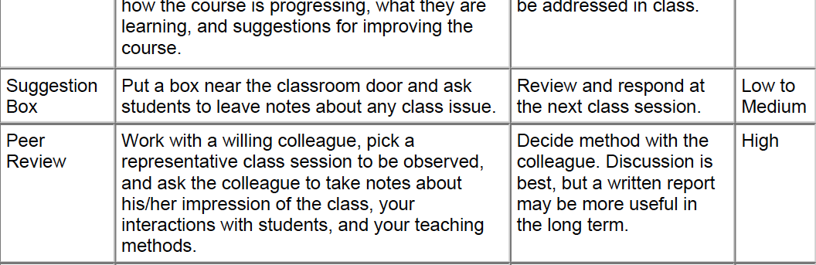

Slide 25
Conclusion
Overview of Classroom Assessment Techniques (CATs)
Benefits of CATs for Teachers and Students
Evaluation Performance of CATs
Different Kinds of CATs Evaluations

Slide 26
References
HAUGEN, Lee, 1999, Strategies to Check Student Learning in the Classroom, Iowa State University of Science and Technology, Center for Excellence in Learning and Teaching
ANGELO, Thomas A. and K. Patricia CROSS, 1993, Classroom Assessment Techniques: A Handbook for College Teachers, Second Edition, San Francisco: Jossey-Bass Publishers

