Slide 1
Instructional Strategies: China vs. US
Bei Dong

Slide 2
The generalizability of this talk is restricted by
Limited teaching experience in teaching Chinese students in China
Area

Slide 3
Teaching Portfolio
Accounting for Managers (MBA, EMBA, and On-line MBA)

Slide 4
MBA Teaching Experience
22 sessions of regular MBA and 6 sessions of EMBA (since Fall 2008)
INTO students (Fall 2011)
Developing on-line MBA (Spring 2014)

Slide 5
Teaching Evaluation

Slide 6
Teaching Evaluation

Slide 7
Goal of Teaching
Motivating, inspiring, uplifting, and convincing the students that they are capable of achieving a lot more than what they have already done
Bright students excel but the average students are also motivated to push themselves to excel
Motivation

Slide 8
Set Up Course Objectives
Consistent with Program Objectives

Slide 9
Course Objectives
Basic Assumptions: future business leaders not accountants.
  Identify problems and opportunities
  Solve problems or take advantage of opportunities
General focus
  Understand accounting
  Use accounting
  Communicate

Slide 10
Syllabus
“Course Objectives:
Accounting Concepts is a course designed for decision makers who are not accountants. For these professionals, accounting is a source of information that can be used to make effective decisions, to identify problems and opportunities in the business world, as well as to suggest ways to solve these problems or take advantage of opportunities. This course will provide you with the opportunity to learn to read general purpose financial statements, appreciate the limitations of the information contained in these statements, understand the impact of management’s choice of the accounting methods used, and analyze relevant managerial data using appropriate tools for decision making, reporting and evaluating performance.”

Slide 11
Organize Course Materials
Consistent with Course Objectives

Slide 12
Understand
Why (MBA and EMBA)
  The importance of accounting information (e.g., Lucent Case)
  Conceptual Framework: reasons and limitations of current GAAP
  Managers’ incentives underlying accounting disclosure
    Case studies (e.g., WorldCom case from HBS)
    Accounting research (e.g., earnings management, positive accounting theory, etc.)

Slide 13
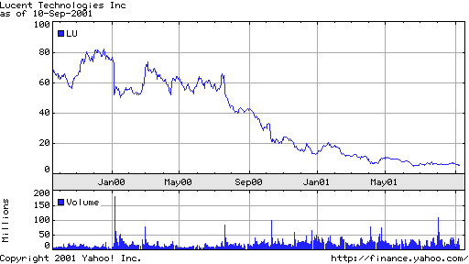
Lucent Stock Price Movements over 2000-2001

Slide 14
Lucent: The Events
1/7/2000 WSJ: “Lucent Technologies Inc., in a rare disappointment, warned that its fiscal first-quarter earnings would fall well below analysts' expectations as a result of shifts in customer demand. The big phone-equipment maker, which has been a stock-market star since its spinoff from AT&T Corp. three years ago, said it expects to earn 36 cents to 39 cents a share for the quarter ended Dec. 31. Analysts surveyed by First Call/Thomson Financial expected the Murray Hill, N.J., company to post a profit of 54 cents a share.” (Stock price went from $72 to about $50, or dropped 30% at the news)
7/21/2000 WSJ: “Lucent Technologies Inc., which has been trying to work its way back into Wall Street's good graces after a disappointing first quarter, surprised investors with a warning that fiscal fourth-quarter revenue and profit would be weaker than expected. The news came as Lucent reported a net loss of $301 million for its fiscal third quarter and formally announced a widely expected spinoff of its microelectronics unit. News of the spinoff, which will create a separate, publicly traded company that could be valued at as much as $85 billion, wasn't enough to save Lucent 's stock, which plunged 16%, or $10.25, to $54.25 in 4 p.m. composite trading on the New York Stock Exchange.”

Slide 15
Lucent: The Events (Cont’d)
10/11/2000 WSJ: “The company, based in Murray Hill, N.J., said it would report revenue of $9.3 billion to $9.4 billion, at the low end of forecasts. It said per-share earnings were in the range of 17 cents to 18 cents a diluted share, compared with 24 cents a year earlier. The First Call/Thompson Financial consensus was that Lucent would earn 27 cents a share.
10/11/2000 FT: “Shares in the world's leading telecommunications equipment company, Lucent Technologies, fell 26 percent, or $8.44, to $23.88 yesterday after the company announced that its fourth-quarter earnings would fall short of market forecasts.”
Accounting Information Moves the Market!

Slide 16
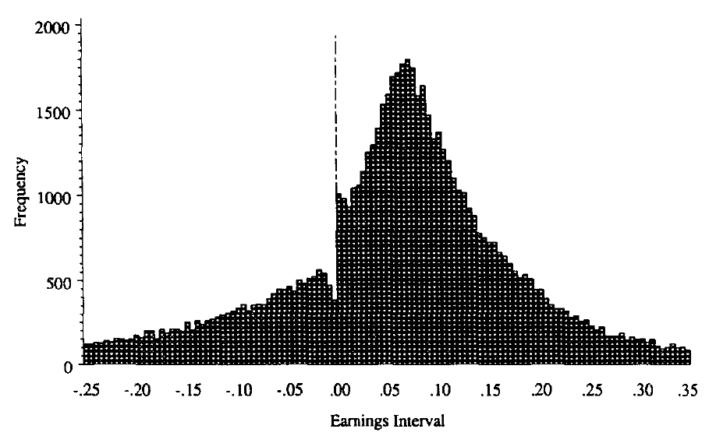
Earnings Manipulation
Burgstahler and Dichev (1998), Journal of Accounting and Economics
    The frequency distribution of reported earnings for 75,999 U.S. Corporation annual earnings over 1976-1994.
    Relative to a smooth distribution, there are too few slight losses and too many slight profits.
It looks like “creative accounting”
is at work
Enron
AOL

Slide 17
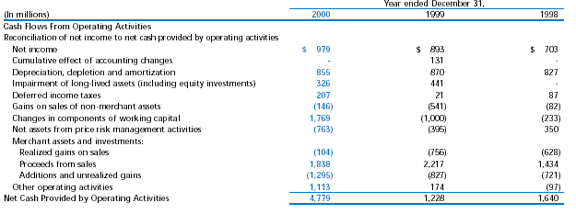
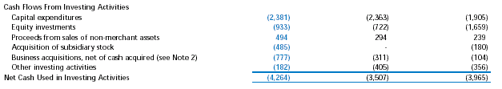
Enron’s Cash Flows

Slide 18
Use
Case studies
  Heavily used in EMBA (seven group projects and one individual project)
  MBA (Non-INTO): two group projects and one individual project
  INTO session: one group project and one individual project

Slide 19
Communicate
Active participation
  Bring in interesting topics
  Encourage quiet students to talk
Group and individual report
Presentations

Slide 20
Teaching Skills

Slide 21
Others
Update cases often
In-class exercises
Let students lead brief preview and review

Slide 22
Syllabus
(contract between instructors and students)
Specify expectations (general and specific)
Evaluation policy
Course policy
Guidelines for all the turn-ins
Detailed schedule of every class meet.

